Slide 1


A
A New Kind of Health Insurance
Filling the growing need for affordable alternatives in the marketplace
Fixed Indemnity Health Insurance

Slide 2

Answering consumer needs.
PivotCare – A new kind of health insurance.
PivotCare Advantages:
Affordable insurance that offers variety of benefits at rates that meet any budget
Includes specific cash payments for both sickness and accidental injuries regardless of other coverage
Benefits do not vary – a fixed dollar amount covers both in-and out-of-network
One of the nation’s largest medical provider networks
PivotCare: The best health plan the market has seen.

Slide 3


Partners
Marketed by Pivot Health
Underwritten by Standard Life and Accident Insurance Company
Allied National, claims administration

Slide 4
Who is Pivot Health?
Founded by innovative experienced insurance leadership
Long term history of working with Independent agents and General agents
Focused on an internet/mobile platform to quickly adapt to market changes using multiple carriers
Demonstrated past experience in this market niche

Slide 5
Who is Standard Life and Accident?
Founded to provide clients realistic life and health insurance products that solve their needs for financial security
In business over 60 years with financial strength and stability with an “A” rating from A.M. Best.

Slide 6
Who is Allied National?
Plans sold through Pivot Health are administered by Allied National, headquartered in Overland Park, KS, and offices in Rockford, IL.
Since 1970, Allied has been a full service third-party administrator offering administration, risk assessment, premium billing, agent contracting and licensing, commission processing ad claim processing with 145 employees, handling $250 million in retail claims annually.

Slide 7
A solution for today’s health insurance crisis
What makes PivotCare unique:
No deductibles and co-insurance limits to meet
Includes specific cash payments for both sickness and accidental injury regardless of other coverage
Critical illness coverage for invasive cancer, stroke, heart attack and end-stage kidney failure
Accidental death and common carrier life insurance benefits included
No Specialist referrals needed
Fixed reliable benefit amounts for: Doctor office visits, Hospital stays, Diagnostic lab tests and x-rays, Ambulance services, Childhood immunizations, MRIs
Hospitalization coverage: Daily benefit, ICU benefit, Surgery benefit
No Claim forms needed
Specific benefits vary by state. See the state specific Reference Guide for state variations.

Slide 8
Additional Benefits
Fracture Benefit | Mental Health Benefit
Burn Benefit | Substance Abuse Benefit
Dislocation Benefit | Ambulance Services
Critical Illness Lump-Sum Benefit | Accidental Death Coverage
Discount Prescription Drug Card
Specific benefit amounts may vary by state. See the state specific Reference Guide for state variations.

Slide 9
Who are candidates for PivotCare?
Short term medical plan buyers
Individuals not eligible for ACA exchange plan
Those refusing/can’t afford ACA coverage
High deductible plan owners—to supplement their coverage

Slide 10


Large and Growing Market
Nearly 25 million in the market for short term medical
Millions with high-deductible health insurance
1200 counties-nearly 40%- will have one or less ACA plan choices in 2018 (roughly 2.4 M Exchange lives)
Over 35,000 may have no coverage in 47 counties

Slide 11
Cost comparisons with
Example* Male, February 2, 1980 DOB, Not subsidy eligible
ACA Plan | Deductible | Monthly Premium
BCBS, Silver | $5,000 | $381.00
BCBS, Silver | $3,500 | $486.00
Short Term Plan | Deductible | Monthly Premium
Pivot Health | $5,000 | $95.26
Pivot Health | $2,000 | $186.85
Fixed Indemnity | Deductible | Monthly Premium
PivotCare, Plan 1 | $0 | $47.00
PivotCare, Plan 5 | $0 | $178.00
With PivotCare, health insurance can cost
hundreds less every month!
No deductibles, no coinsurance.
*Example pricing obtained from HealthCare.com and Pivot Health.

Slide 12

Advantages
Product features:
5 plans to choose from—match your client’s budget and coverage needs
First Health PPO Network—Not required to use network, but network provides best use of benefits
Added benefits:
Accident & Critical Illness lump sum benefits
AD&D insurance benefit

Slide 13

Advantages
Affordable cost and easy enrollment:
Fraction of cost of ACA plans
Accept/reject medical questions
Agent-guided enrollment process
Benefits payments are made to the Providers with any excess sent to the insured

Slide 14

and ACA
PivotCare is limited benefit health insurance:
Benefits are not intended to cover all medical expenses.
It is not qualifying health coverage (“minimum essential coverage”) that satisfies ACA Individual Mandate for health insurance. Those without minimum essential coverage may owe an additional payment with their taxes.
Plan benefits vary by state.

Slide 15
Highlights: Plans 1, 2, 3
 | Plan 1 | Plan 2 | Plan 3
Primary Doctor Office Visit | $100/day—injury $50/day—sickness 2 times per year | $100/day—injury $50/day—sickness 2 times per year | $120/day—injury $60/day—sickness 3 times per year
Hospitalization | $1,000/day—injury $500/day—sickness 365 days max | $2,000/day—injury $1,000/day—sickness 365 days max | $3,000/day—injury $1,500/day—sickness 365 days max
Intensive Care (paid in lieu of and not in addition to the Hospitalization Benefit) | $2,000/day—injury $1,000/day—sickness 30 days max per cal yr | $4,000/day—injury $2,000/day—sickness 30 days max per cal yr | $6,000/day—injury $3,000/day—sickness 30 days max per cal yr
Surgery | $500 a day (no maximums) | $1,000 a day (no maximums) | $1,000 a day (no maximums)
Emergency Room | $100/day—injury 2X/yr $50/day—sickness 1X/yr | $150/day—injury 2X/yr $75/day—sickness 1X/yr | $200/day—injury 2X/yr $100/day—sickness 1X/yr
Wellness Benefits | $50/day 1X/yr | $75/day 1X/yr | $100/day 1X/yr
Diagnostic X-ray, Lab | $50/test/day—injury $25/test/day—sickness 2 test days/cal yr | $100/test/day—injury $50/test/day—sickness 2 test days/cal yr | $150/test/day—injury $75/test/day—sickness 2 test days/cal yr
Use any doctor or hospital! See the state specific Reference Guide for state variations.

Slide 16
Highlights: Plans 4 & 5
 | Plan 4 | Plan 5
Primary Doctor Office Visit | $140/day—injury $70/day—sickness 3 times per year | $160/day—injury $80/day—sickness 4 times per year
Hospitalization | $4,000/day—injury $2,000/day—sickness 365 days max | $6,000/day—injury $3,000/day—sickness 365 days max
Intensive Care | $8,000/day—injury $4,000/day—sickness 30 days max per cal yr | $12,000/day—injury $6,000/day—sickness 30 days max per cal yr
Surgery | $1,000 a day (no maximums) | $1,500 a day (no maximums)
Emergency Room | $300/day—injury 2X/yr $150/day—sickness 1X/yr | $400/day—injury 2X/yr $200/day—sickness 1X/yr
Wellness Benefits | $100/day 1X/yr | $125/day 1X/yr
Diagnostic X-ray, Lab | $200/test/day—injury $100/test/day—sickness 2 test days/cal yr | $400/test/day—injury $200/test/day—sickness 2 test days/cal yr
Use any doctor or hospital! See the state specific Reference Guide for state variations.

Slide 17

PPO Network
First Health is the premier PPO network with superior access in urban, suburban and rural markets throughout the country.
REMEMBER: No requirement to use network. Fixed dollar benefits will pay both in or out of network, but lower total cost by using First Health Network.

Slide 18
Claim Example v. Major Med: ILLNESS Claim*
Expense related to Appendectomy | Average Costs | Pivot Care (Plan 3) Reimbursement Use any doctor or hospital! | Standard Major Medical Plan pays: $5,000 Deductible & 80/20 Coinsurance
Hospital Confinement (4 days @ $2,296/day) | $9,184.00 | $12,000.00 | $3,347.20
Surgery (ruptured, infected appendix) | $3,822.78 | $1,000.00 | $3,058.22
Anesthesia | $1,690.00 | $200.00 | $1,352.00
TOTAL | $14,696.78
 | Plan Pays | $13,200.00 | $7,757.42
 | Deductible & Coinsurance paid by insured | N/A | $5,000 Deductible $1,939.36 Coinsurance
 | Total Balance to be paid by insured | $1,496.78 | $6,939.36
*Example is for illustration purposes only. Specific benefits vary by plan and may vary by state.

Slide 19
Claim Example v. Major Med: INJURY Claim*
Expense related to car accident: contusions and leg fracture | Average Costs | Pivot Care (Plan 3) Reimbursement Use any doctor/hospital! | Standard Major Medical Plan pays: $5,000 Deductible & 80/20 Coinsurance
Hospital Confinement (3 days @ $2,296/day) | $6,888.00 | $9,000.00 | $1,510.40
Surgery (on leg fracture) | $5,978.00 | $1,000.00 | $4,782.40
Anesthesia | $2,460.00 | $200.00 | $1,968.00
ER Admission | $2,168.00 | $200.00 | $1,734.40
 | Fracture benefit of plan | $2,500.00 | N/A
TOTAL | $17,494.00
 | Plan Pays | $12,900.00 | $9,995.20
 | Deductible & Coinsurance paid by insured | N/A | $5,000 Deductible $2,498.80 Coinsurance
 | Total to be paid by insured | $4,594 | $7,498.80
*Example is for illustration purposes only. Specific benefits vary by plan and may vary by state.

Slide 20
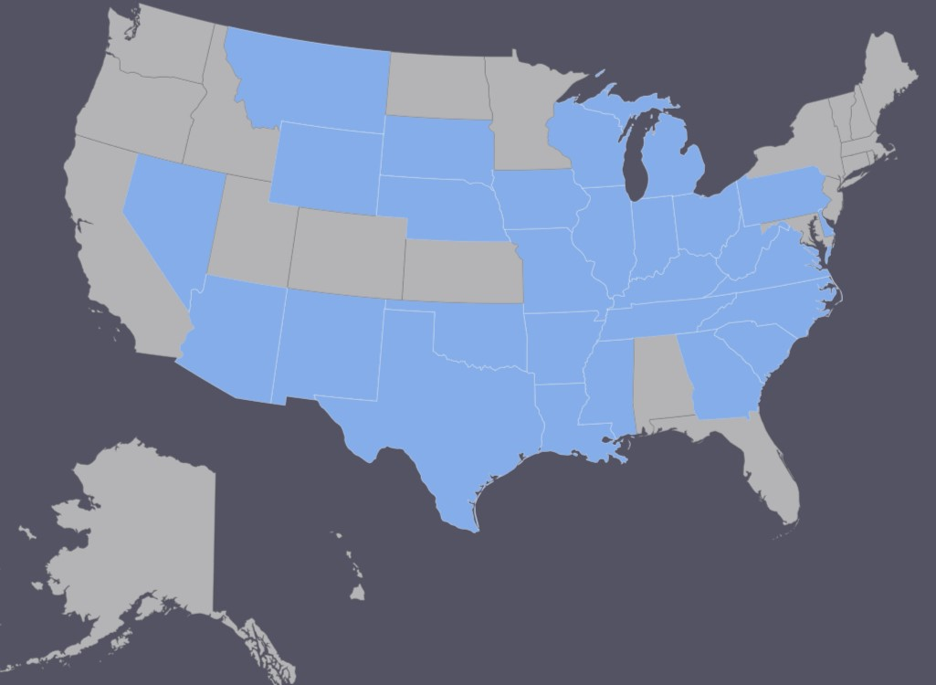
State Availability
Arizona | Nevada
Arkansas | New Mexico
Delaware | North Carolina
Georgia | Ohio
Illinois | Oklahoma
Indiana | Pennsylvania
Iowa | South Carolina
Kentucky | South Dakota
Louisiana | Tennessee
Michigan | Texas
Mississippi | Virginia
Missouri | West Virginia
Montana | Wisconsin
Nebraska | Wyoming

Slide 21
PivotCare—Medical/eligibility kick outs
Height & weight must be within acceptable range.
“Yes” to any of 8 questions: coverage cannot be issued
1. Unemployed or employed in specified hazardous occupation?
2. Disabled or hospitalized in last 6 months?
3. Pregnant, an expectant parent or in process of adopting?
4. Participated in specified hazardous activities (sky diving, hang gliding, etc.)?
5. In past 2 years, had driver’s license suspended, 3 or more traffic violations, had DUI or been arrested?
6. In past 2 years, been advised to have medical test or procedure that has not yet been performed?
7. Within last 5 years, had abnormal test results, been diagnosed or treated for AIDS or tested positive for HIV?
8. Within last 5 years, diagnosis, symptoms, abnormal test result or any treatment for any of the major conditions listed on application? (i.e. cancer, heart, stroke, COPD, liver, kidney, diabetes, Hep C, etc.)
(Medical questions may vary in some states.)

Slide 22
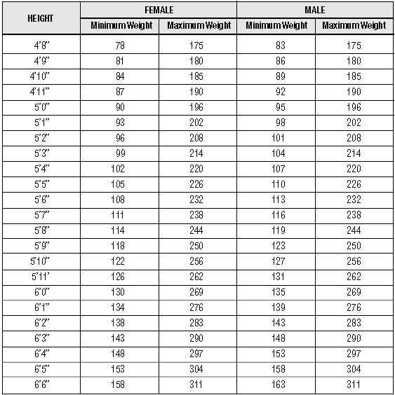
Height & Weight Chart
Any applicant or proposed insured 15 years and older, who falls outside the height and weight range on this chart is not eligible for coverage.

Slide 23
Limitations & Exclusions
Waiting Period Limitation
A sickness, mental or nervous disorder or substance abuse treatment or medical care will not be covered during the first 30 days after the effective date for each Covered Person under the policy. Medicare care for an accident is covered immediately following the effective date.
Pre-Existing Condition Limitation
Pre-Existing Condition Limitation means a condition not otherwise excluded by name or specific description for which medical advise, testing, care, treatment or medication was given or was recommended by, or received from, a Physician within 12 months before the Covered Person’s Effective Date: or that would have caused a reasonably prudent person to seek medical diagnosis or treatment within 12 months before the Covered Person’s effective date.
Loss caused by or relating to the pre-existing condition is not covered for the first 12 months after the effective date of each Covered Person. A pregnancy that was conceived prior to the effective date is also considered a pre-existing condition.

Slide 24
Limitations & Exclusions
No coverage shall be provided and no benefits will be paid for any loss resulting in whole or in part from, or contributed to, or as a natural and probably consequence of any of the following:
Suicide or any attempt at suicide or intentionally self-inflicted injury or any attempt at intentionally self-inflicted injury or any act of auto-eroticism, while sane or insane;
Travel or flight in or on (including getting in or out of, or on or off of) any vehicle used for aerial navigation, if the Covered Person is:
riding as a passenger in any aircraft not intended or licensed for the transportation of passengers;
performing, learning to perform or instructing others to perform as a pilot or crew member of any aircraft; or
riding as a passenger in an aircraft owned, leased or operated by the Covered Person’s employer;
Declared or undeclared war, or any act of declared or undeclared war;
Full-time active duty in the armed forces, National Guard or organized reserve corps of any country or international authority. (Unearned premium for any period for which the Covered Person is not covered due to his/her active duty status will be refunded. Loss caused while on short-term National Guard or reserve duty for regularly scheduled
training purposes is not excluded.);
The Covered Person’s being intoxicated (defined as blood alcohol concentration equal to or in excess of .08 gms/dl blood alcohol). This applies whether or not the Covered Person is charged with any violation in connection with a loss and there is no need to prove a loss was caused, contributed to, or resulted from the excessive blood alcohol concentration;
The Covered Person’s: a) voluntary use of illegal drugs; b) the intentional taking of over the counter medication not in accordance with recommended dosage and warning instructions; and c) intentional misuse of prescription drugs;
The Covered Person’s commission of or attempt to commit a felony;
The Covered Person being engaged in an illegal occupation;
Services and supplies which are not medically necessary to treat a covered loss (other than as stated in the Wellness and Preventive Care Benefit);

Slide 25
Limitations & Exclusions
No coverage shall be provided and no benefits will be paid for any loss resulting in whole or in part from, or contributed to, or as a natural and probably consequence of any of the following:
Services and supplies which are received without charge or legal obligation to pay or would not normally be paid in the absence of insurance;
Services and supplies which are received outside of the United States of America, its possessions and territories;
Dental care or treatment unless due to an injury to a sound and natural tooth;
Cosmetic surgery or reconstructive surgery, including breast reduction and surgery to repair, replace, or remove breast implants; however, this Exception does not apply when surgery is required:
To repair a birth defect of a child born to you and continuously covered under your policy from birth; or
For reconstructive surgery following a covered mastectomy.
Any covered loss that is covered under any state or federal Worker’s Compensation, Policyholder’s Liability law or similar law;
Any mental or nervous disorder or substance abuse unless such coverage is expressly provided herein;
Any procedure for refractive correction, eye refraction or the purchase or fitting of vision or hearing aids, cochlear implants and related
devices;
Pregnancy or maternity unless such coverage is expressly provided herein. Complications of Pregnancy are not excluded;
Participating in hazardous occupations or other activity including participating, instructing, demonstrating, guiding or accompanying others in the following: professional or semi-professional sports, extreme sports, organized body contact sports, parachute jumping, hot-air ballooning, hang-gliding, base jumping, mountain climbing, bungee jumping, scuba diving, sail gliding, parasailing, parakiting, rock or mountain climbing, cave exploration, parkour, racing including stunt show or speed test of any motorized or nonmotorized vehicle, rodeo activities, or similar hazardous activities. Also excluded is injury received while practicing, exercising, undergoing conditional or physical preparation for such activity;
A custodial institution, domiciliary care or rest cures;
Weight reduction or treatment of obesity, including exogenous, endogenous or morbid obesity; or
Diagnosis or treatment (including surgery) of sexual dysfunctional disorders or inadequacy, or transsexual surgery.

Slide 26
FAQ’s
Agent Appointments & Commissions
How long does it take to get appointed?
A: Appointments are typically turned around within 72 business hours.
If I am already appointed with Standard Life and Accident Insurance Company why do I have to register separately with Pivot Health?
A: PivotCare is an exclusive offering through Pivot Health. You must be appointed separately for this product.
How will my clients’ coverage be renewed?
A: Renewals are automatic. Upon enrollment, your clients provide PivotCare with payment information so we can renew the member automatically unless the member calls to cancel. PivotCare will send an e-mail notification to the member 60 days in advance of their renewal, reminding them of their automatic renewal.
Where do I go for support?
A: For questions, please call Agent Services at 800-319-7061 or email agentservices@adrithealthgroup.com.

Slide 27
FAQ’s
Product Features & Benefits
Is there a deductible and copay?
A: No. There are no deductibles or copays for benefits. Claims are paid at a fixed indemnity payment.
Is there any Rx coverage or DME coverage?
A: No, however, PivotCare does include a discount prescription drug card.
Benefit accumulation period?
A: Calendar year benefits.
What is the Lifetime Maximum policy limit?
A: There is no lifetime maximum. Each benefit category has a maximum per year.
What are the valid ages of dependents?
A: Dependents can be age 30 days old to age 25. If a child is added to the policy they must be at least 30 days old and have had passed their first wellness visit to be eligible. Dependents should be terminated at age 26.
What expense is payable under the Ambulatory Surgical Facility Benefit?
A: The ASF benefit is payable for ASF expense or for outpatient hospital operating room services.
Grace period claims, are they paid without premium or suspended?
A: Suspended until the premium is received.

Slide 28
What is the reinstatement rule if a policy lapses?
Coverage lapsed over 45 days requires a completed new business application but qualifies for reinstatement with a lapse in coverage. Coverage lapsed 180 days or longer cannot be reinstated and the individual must reapply for coverage. Contact Allied National Customer Service for reinstatement information.
A: 45 days after the policy has lapsed and within 180 days, submit a fully completed application and premium payment to Allied National. Underwriting approval required—approval with no lapse in coverage if submitted within 60 days of lapse date, otherwise approve with lapse in coverage. No limit on the number of times client can reinstate.

Slide 29
After enrolling, members receive:
Welcome email including Member ID and access to the Member Portal.
Hardcopy policy documents sent to the home address on file.
The 30-day period begins on the member’s effective date.
All enrollees are provided a 30-day right to examine the limited benefit policy with the option to cancel coverage back to the original effective date. If a member chooses to cancel their membership within the 30-day period, they will receive a full refund of monthly premiums.
Access to fulfillment materials at a1healthcare.com/members or by calling (800) 269-3563.
For agent use only. Not to be used for sales or marketing purposes.

Slide 30
Contact Information
Allied National c/o Global Care
P.O. Box 247
Alpharetta, GA 30009-0247
Claims Assistance & Questions: (844) 630-7500
Member Services
csr@a1healthcare.com
(800) 269-3563
Agent Services
agentservices@adroithealthgroup.com
(800) 319-7061
Collections & Payments
pay@a1healthcare.com
(800) 391-1905
Commission Inquiries
commissions@a1healthcare.com
For agent use only. Not to be used for sales or marketing purposes.

Slide 31
A
A New Kind of Health Insurance
Filling the growing need for affordable alternatives in the marketplace
Fixed Indemnity Health Insurance

